Slide 1

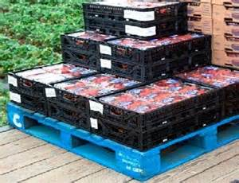
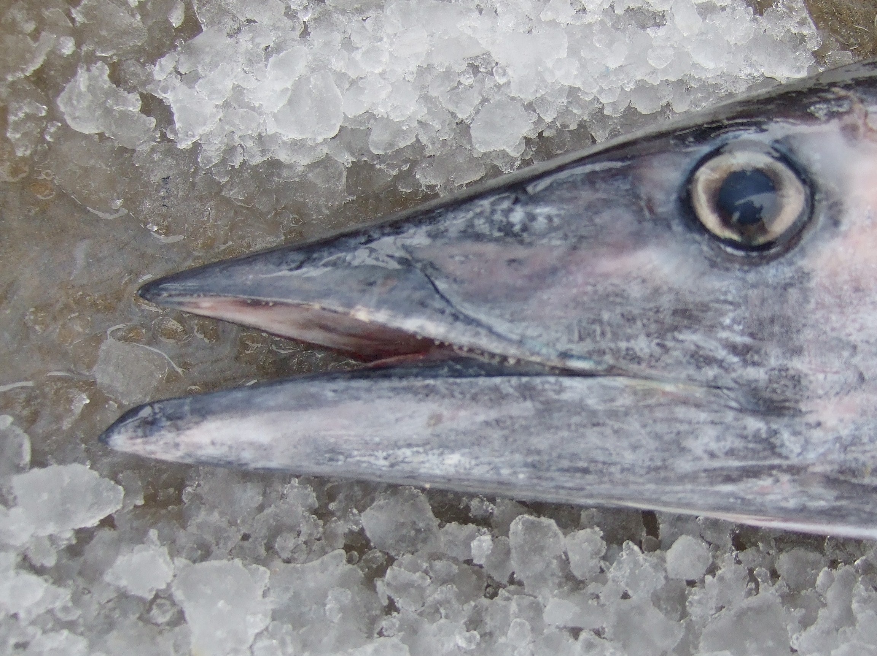

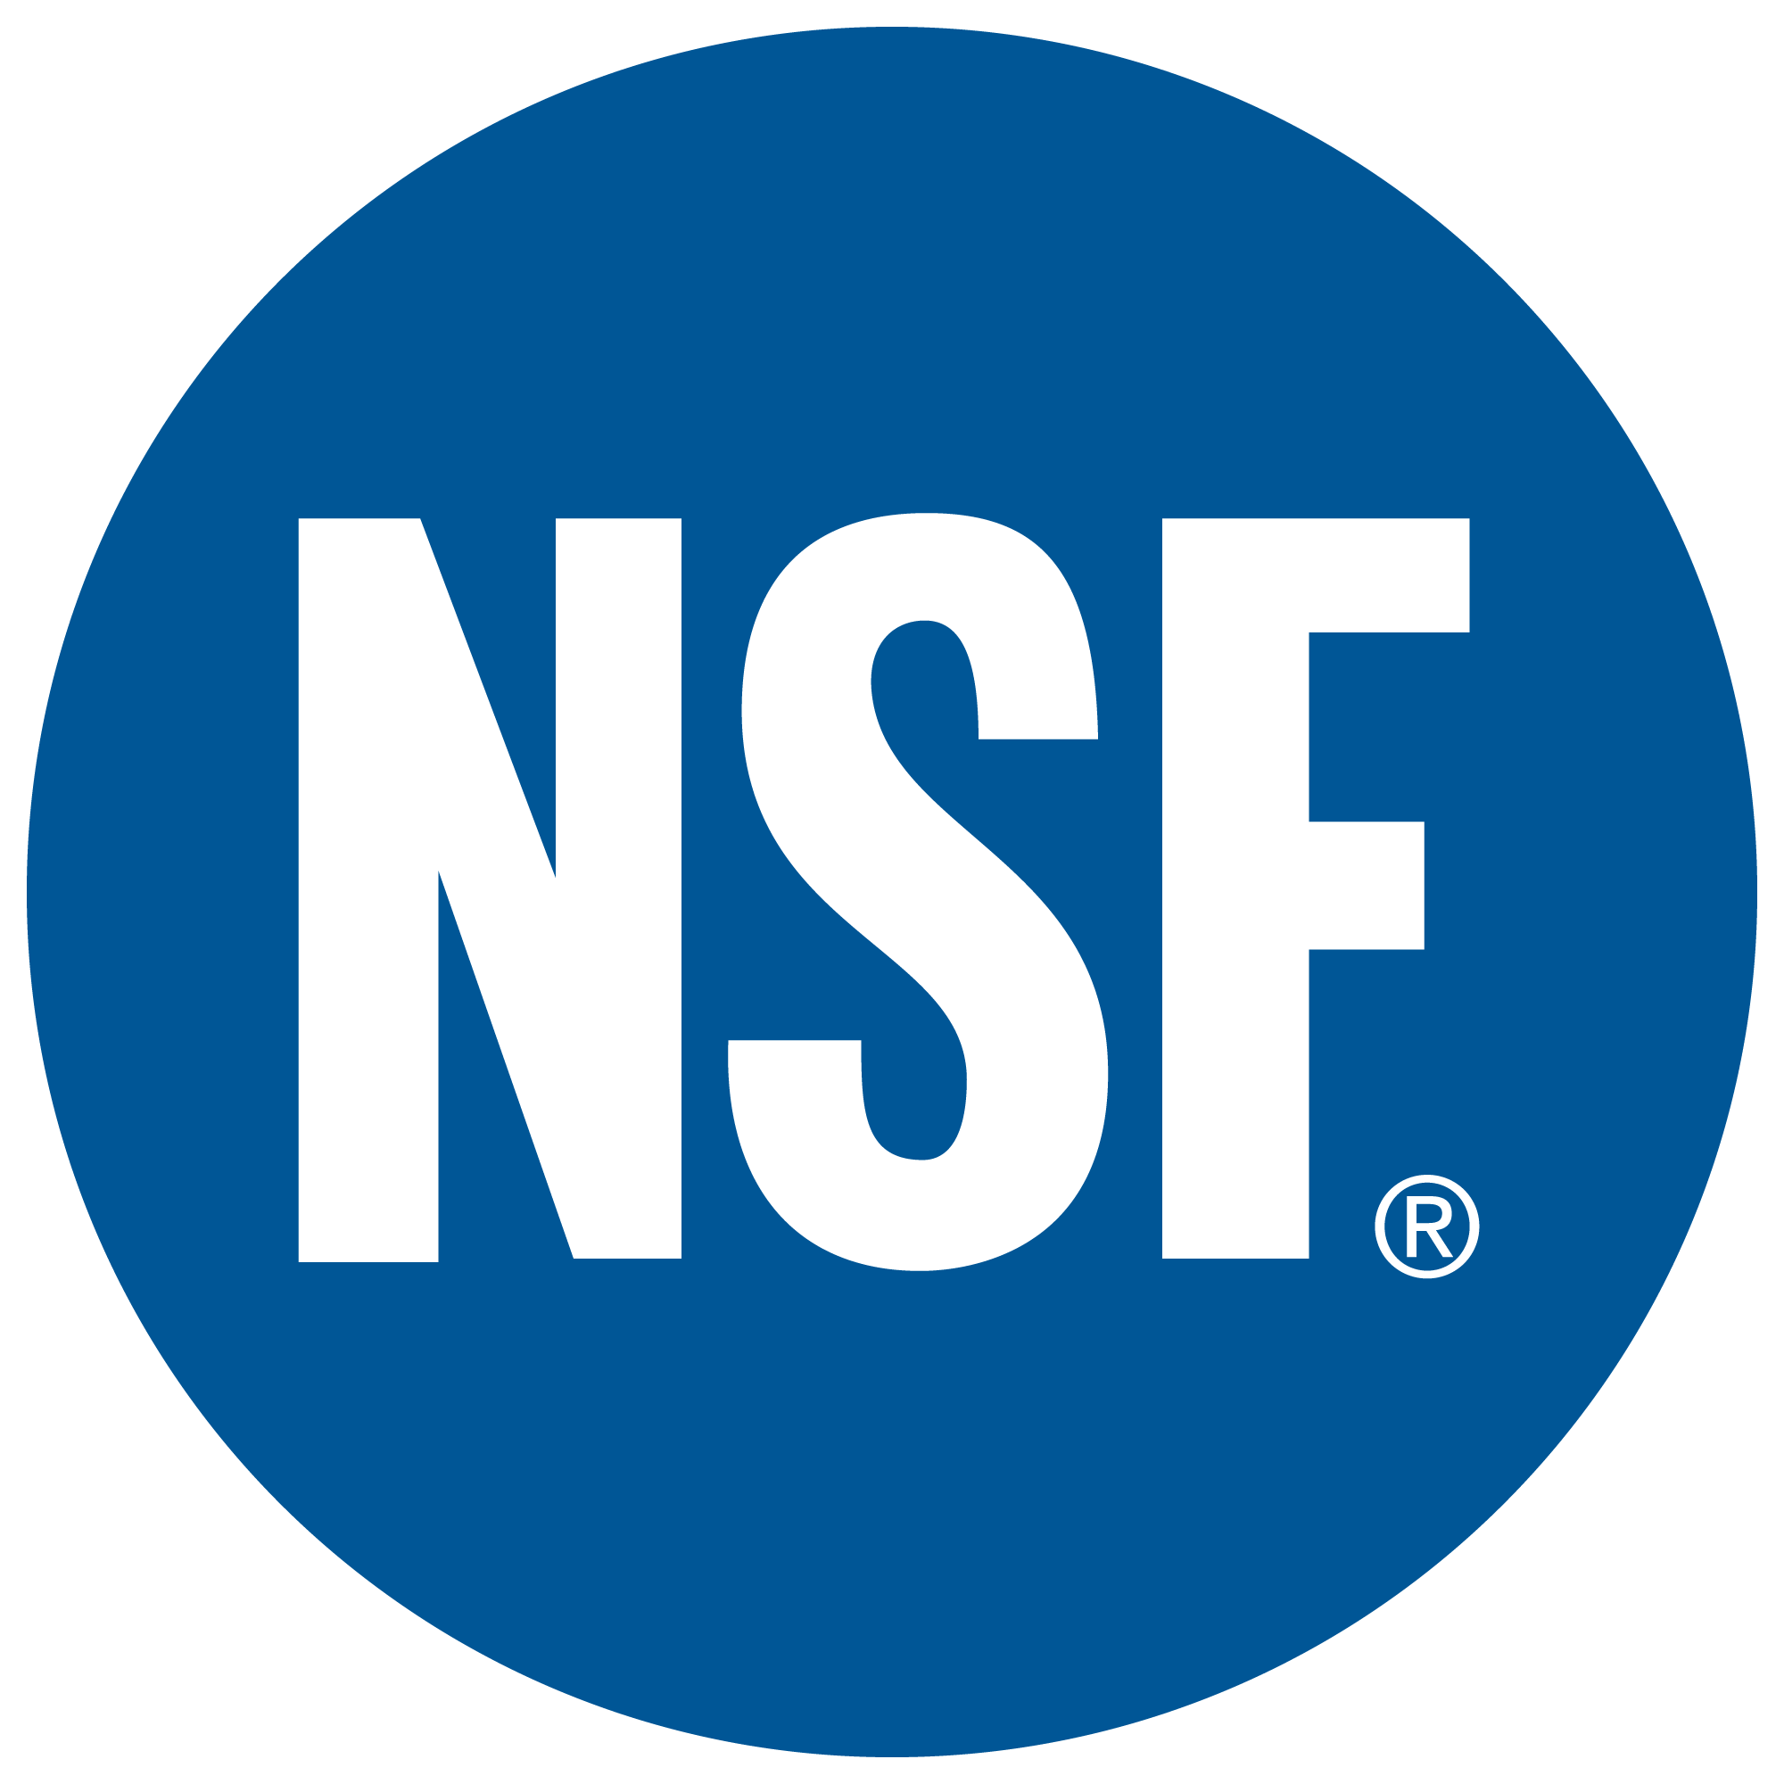

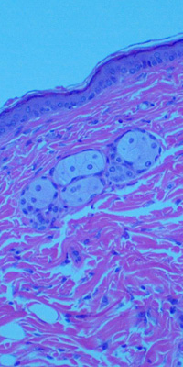
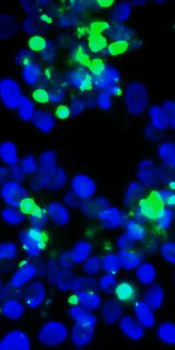
JC 9465 ROS
Consortium for Food Quality and Safety Assurance
Improving Food Safety
Food Sterilization and Preservation
Picture

Slide 2
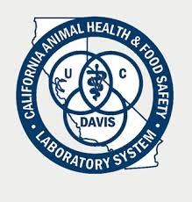
Consortium for Applied (Chemical Sterilization) – Members
Advanced Engineering and Research for Chemical Liquid Oxygen based disinfectant
Jenfitch, Inc.
Advanced oxidation ozone research for consumables
Collaboration Partner
University of Davis with Dr. Suslow

Slide 3
Technology Flow – from Concept to Market
Pioneer Growers
Murphys & Sons
Industry
Western PreCooling
City of Martinez
Jenfitch
TAMUCC / TAMUS
Academia
Univ of CA-Davis, CA
Univ of Florida
Research Technology Maturity Market

Slide 4
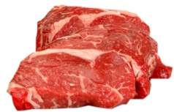
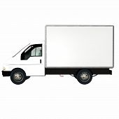

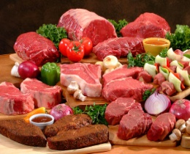
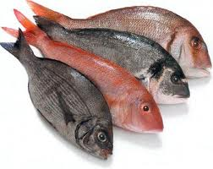
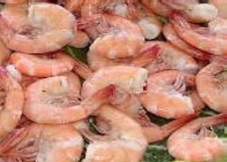
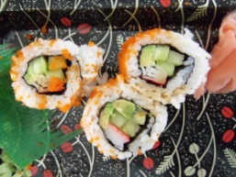
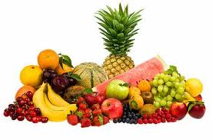
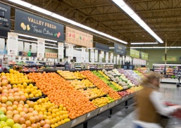
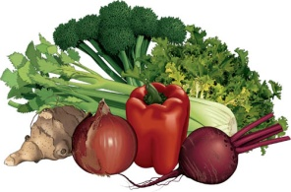

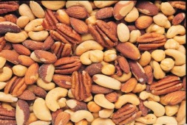
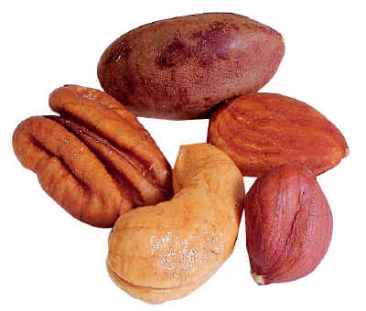
Pathogen Contamination / Quality Degradation Opportunities
Production &
Processing
Storage &
Distribution
In-Store
Processing
Transport
Transport
Display
Distribution
Texas
California
Florida
Canada
Mexico

Slide 5
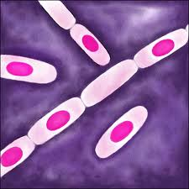
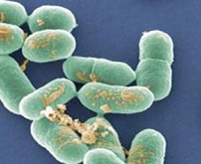
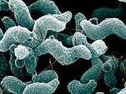
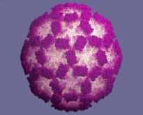
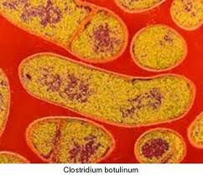
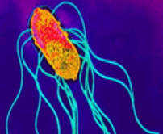
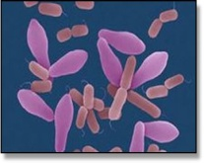
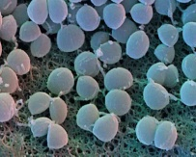
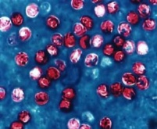
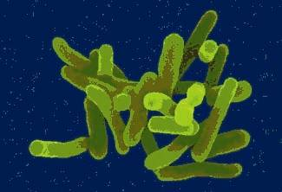
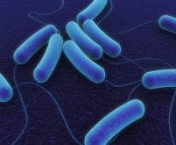
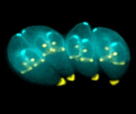
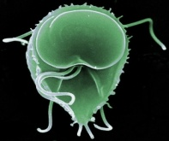
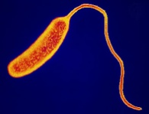

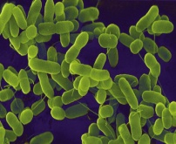
16 Most Common Food-borne Pathogens
Bacillus cereus
Undercooked Foods
Food poisoning
Listeria monocytogenes
Produce, dairy, seafood
Meningitis, Septicemia
Campylobacter jejuni
Contaminated Poultry
Enteritis
Norwalk virus
Raw oysters, salads
Gastroenteritis
Clostridium botulinum
Poorly–preserved foods
Botulism
Salmonella
Meat, poultry, dairy
Enteric fever
Clostridium perfringens
Undercooked meat & poultry
Food poisoning
Staphylococcus aureus (MRSA)
Ham, poultry, potato salad, sauces…
Meningitis, Osteomyelitis, Toxic Shock…
Cryptosporidium parvum
Waterborne pathogen
Severe diarrhea, vomiting
Shigella
Salads, produce, dairy, poultry
Severe diarrhea, vomiting
Escherichia coli
Poorly prepared meats & produce
Food poisoning
Toxoplasma gondii
Raw, undercooked food
Toxoplasmosis
Giardia lamblia
Feces contaminated food
Severe diarrhea, vomiting
Vibrio (>80 species)
Undercooked fish, shellfish
Gastroenteritis, Cholera, Septicemia
Hepatitis A
Shellfish, iced drinks
Liver disease
Yersinia enterocolitica
Raw milk, pork, water, raw meat
Enterocolitis

Slide 6
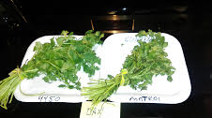
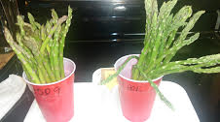
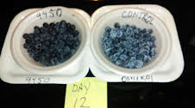
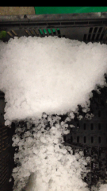


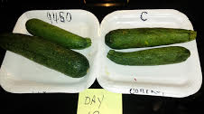
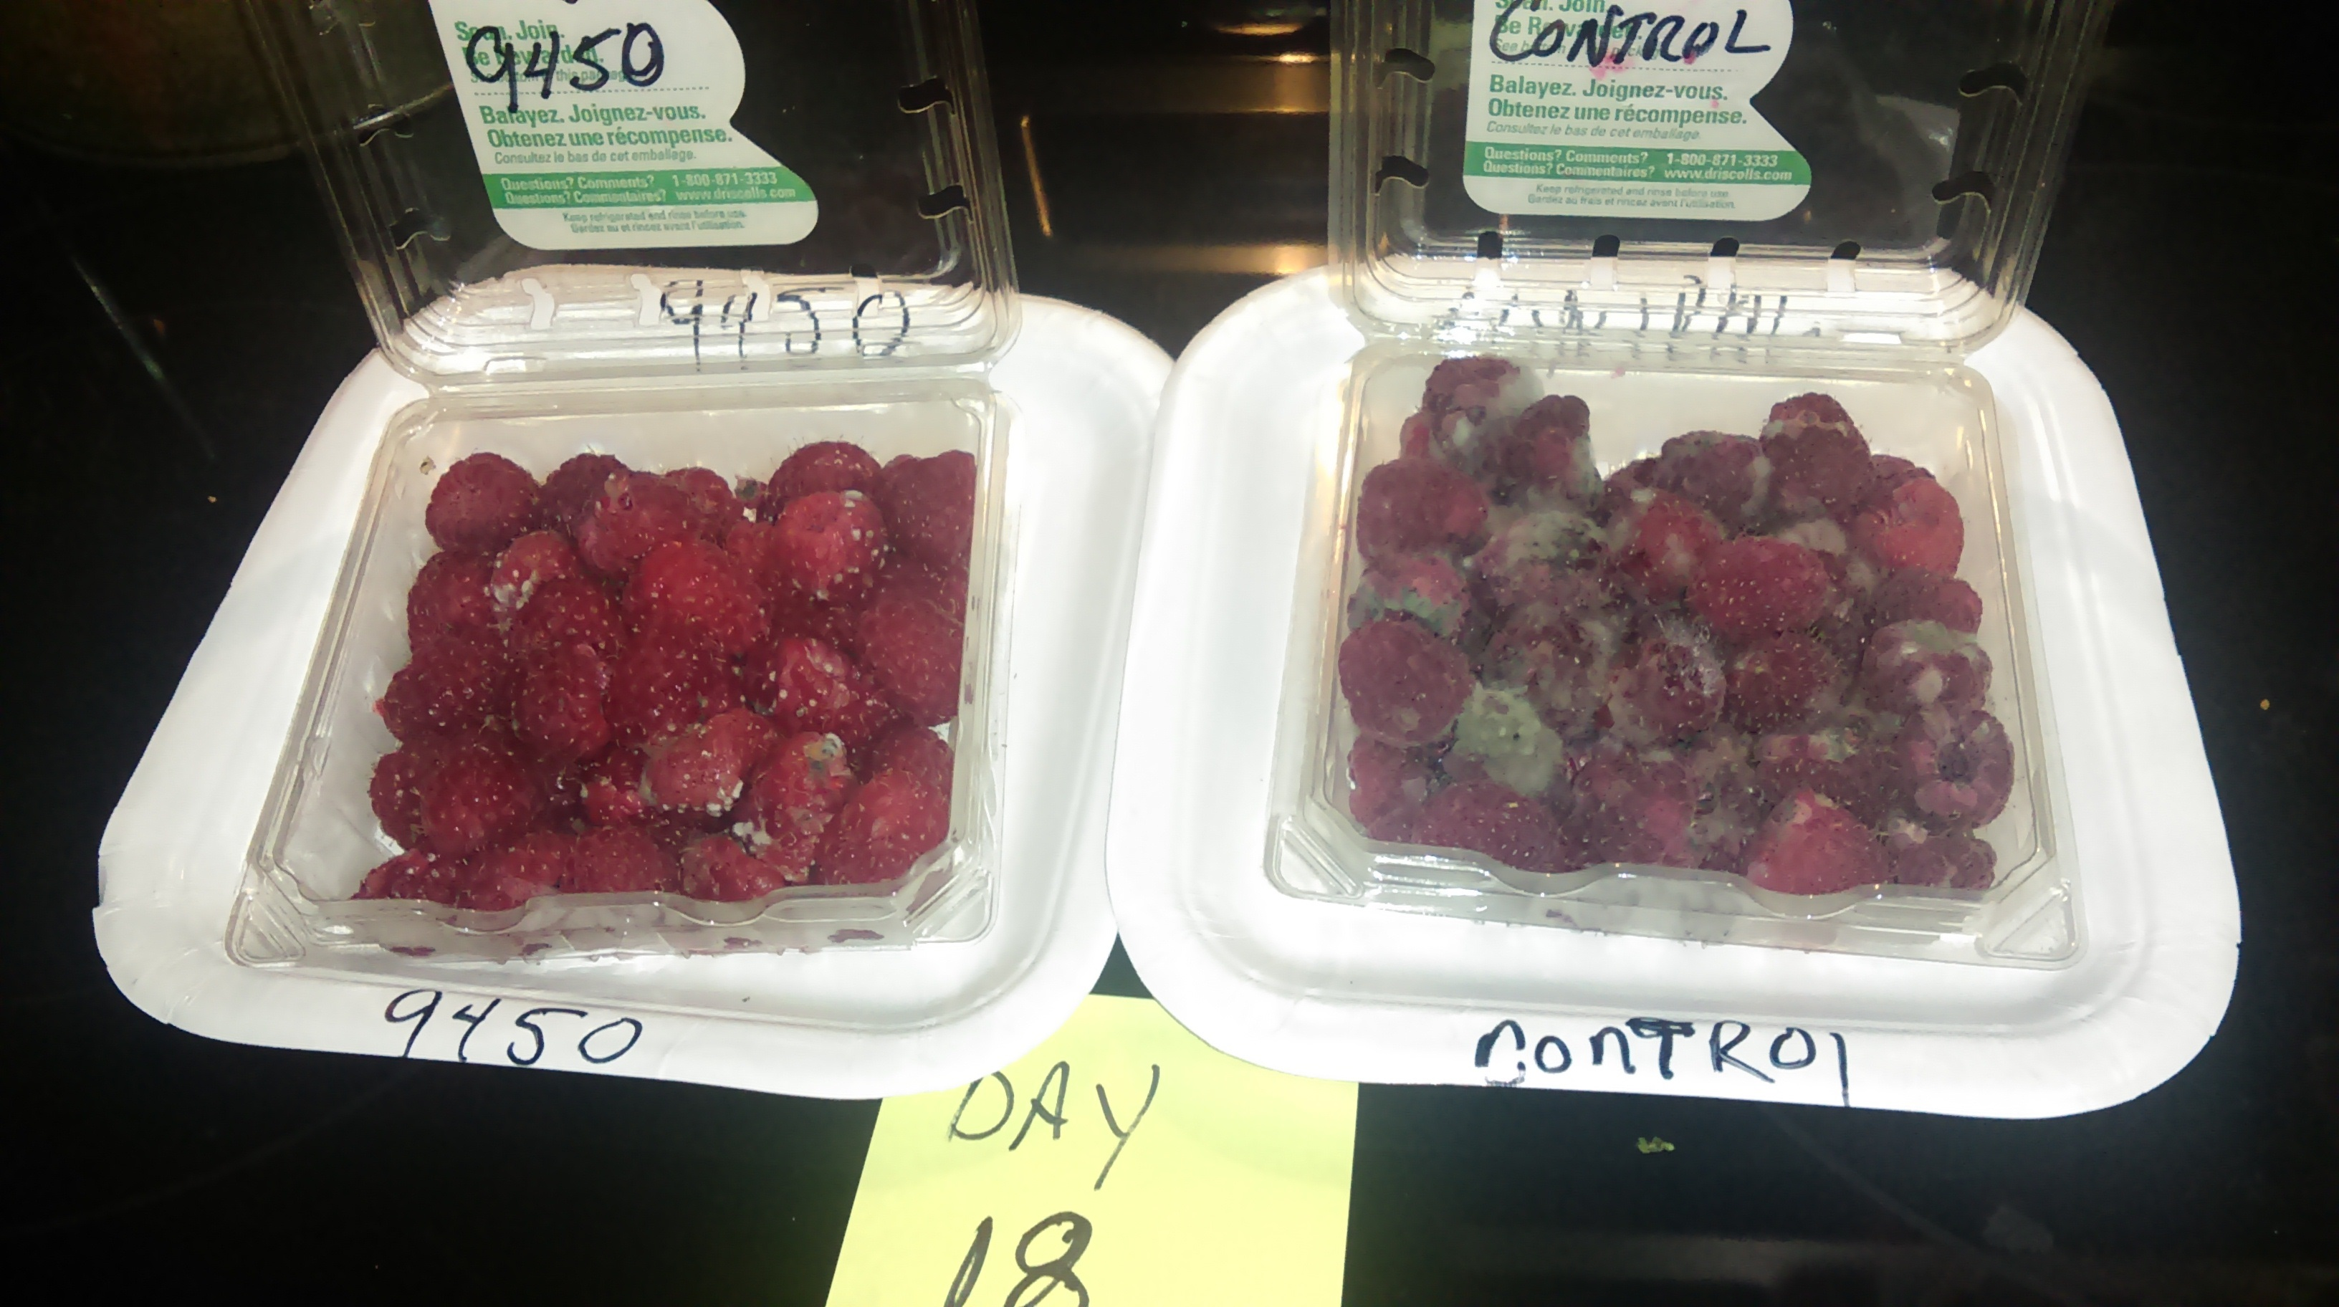
PICTURES of product results in effected products in general--------------------------------
What is JC 9465/9450 ROS?
Oxidizes the outer cell membranes of microorganism using available electrons
Strong disinfectants transfers electrons to the cell wall quickly
JC 9465 can quickly kill bacteria, viruses & other pathogens, up to a
log 5-6 reduction, no change in the characteristics of foods.
Pathogens don’t develop resistance to JC 9465
The higher the EV value, the faster microorganisms die
PICTURES of product results in effected products in general--------------------------------

Slide 7
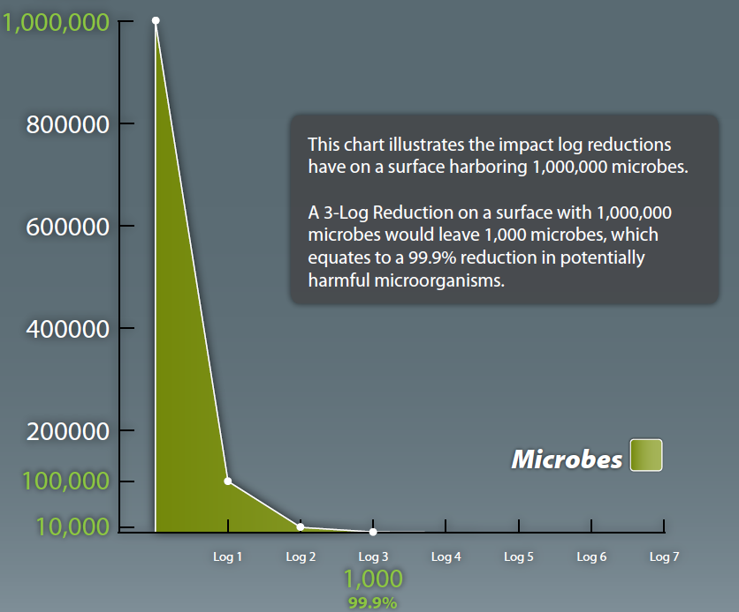
JC 9465 can achieve up to a 5-6 Log reduction in pathogen loading
JC 9465
TARGET
Industry
Standard
100
99.99%
10
99.999%
1
99.9999%

Slide 8
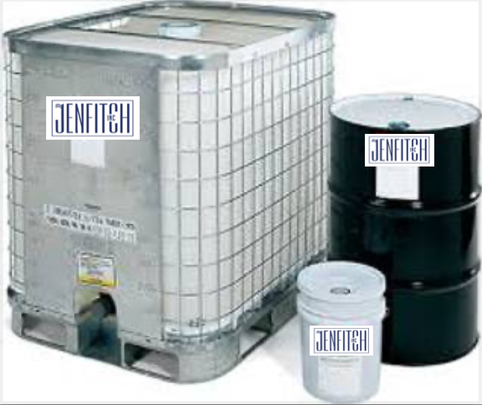
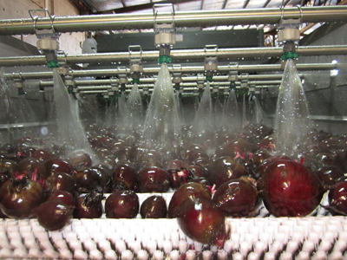
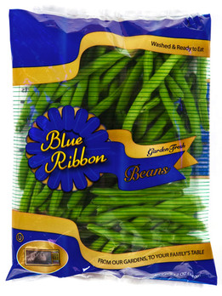
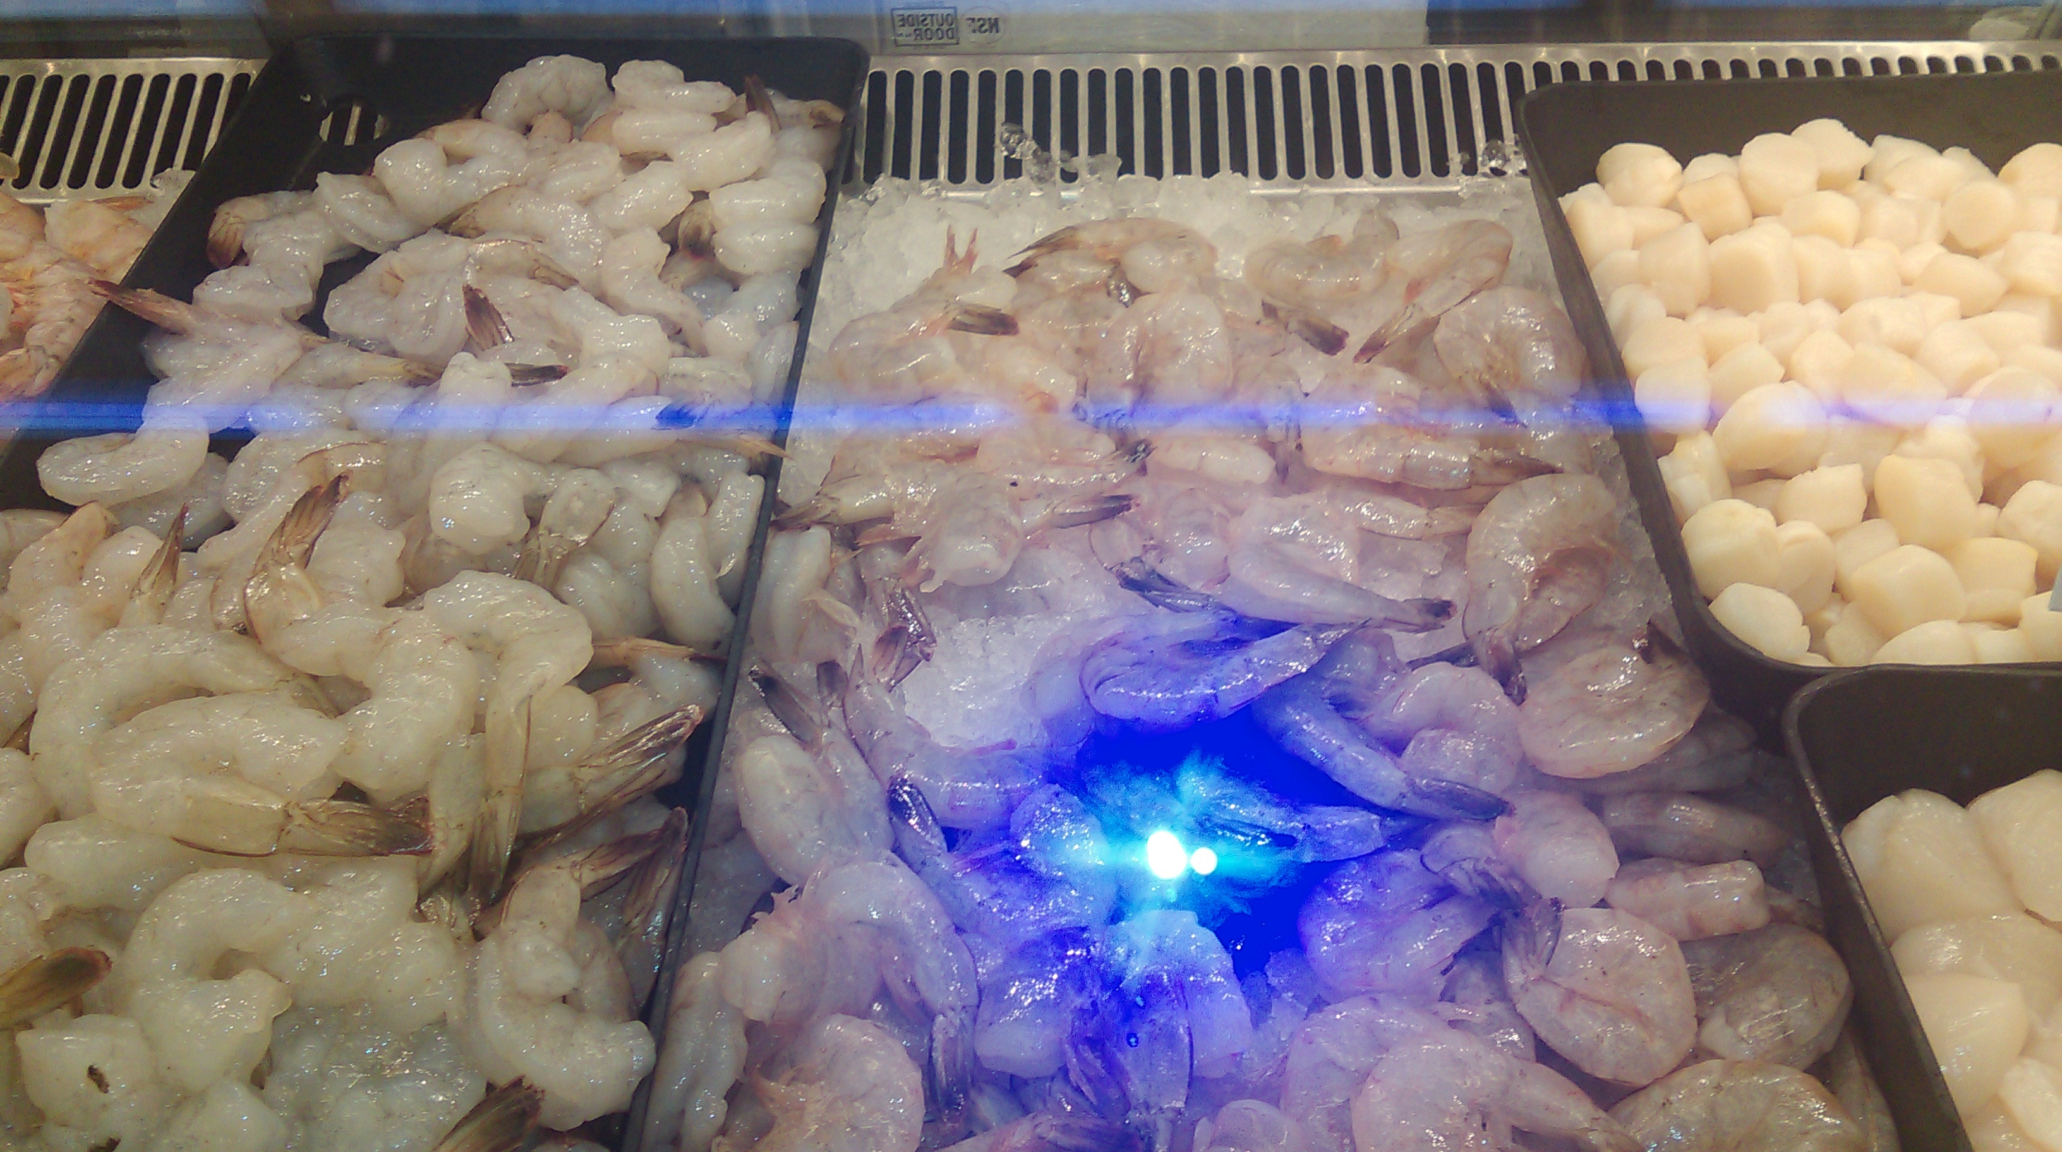
Jenfitch Sterilization Intervention Opportunities
JC9465 ROS
Bacteria free ice
Post Harvest wash
Extended Shelf Life
In Packaging

Slide 9
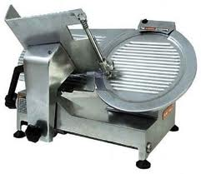
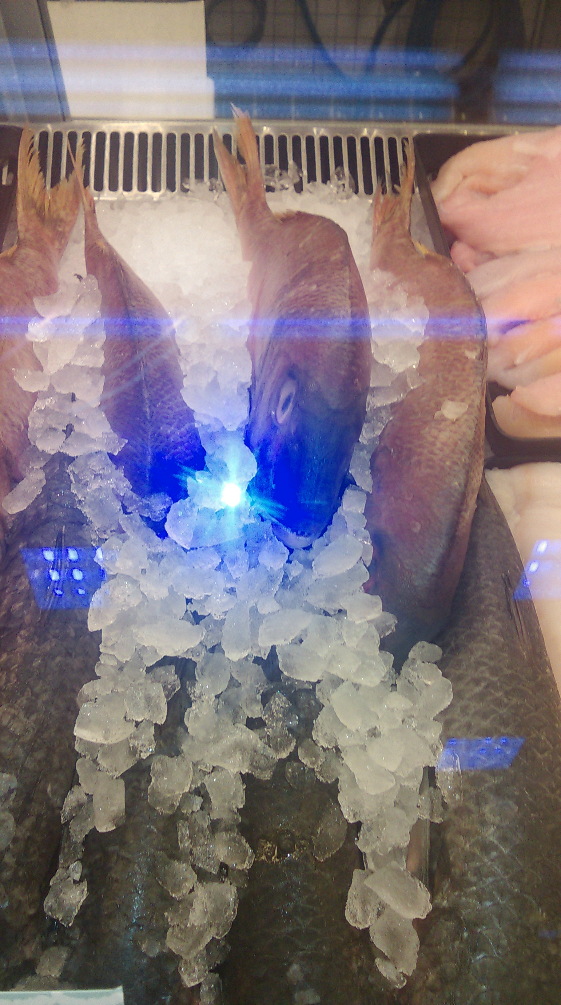
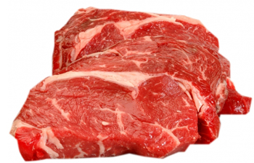
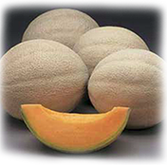
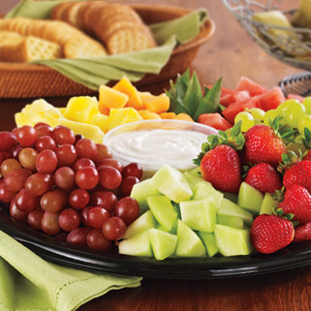
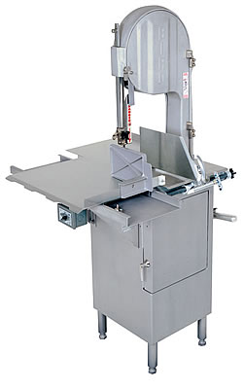
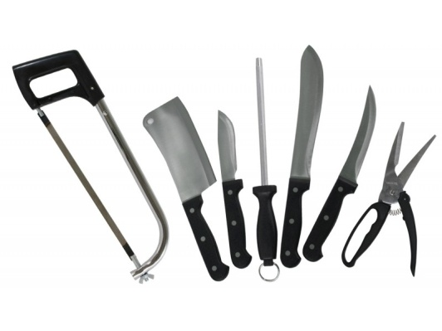
In-Store Intervention Opportunities
Disinfecting as it melts
Fruits and veggies picture

Slide 10


Produce Shelf Life Extension with no Change in Taste
JC 9465 ROS can improve shelf life. The photo to the left demonstrate fresh raspberries from a grocery store rinsed with JC 9465. 12 days later the raspberries that were not treated started showing mold. The JC 9465 treated raspberries are still fresh and marketable. 18 days after purchase the JC 9465 started showing mold for the first time. The average shelf life in a store is 6 days.

Slide 11
APPLICATIONS
APPLICATIONS FOR JC 9465 ROS
Control of Biofilm on any wet/dry surface. Supplier application extends shipping life of produce, increases product consumption safety and liability
Improve shelf life of produce, seafood and meat products.
Application in-store increases shelf life with no reduction in taste to consumer
Improve safety of ice making system
Lower bacteria counts on carts and trays

Slide 12
REMOVES BIOFILM
BIOFILM
Leading cause of short shelf life
Forms a film on the surface that protect the colony from most disinfectants
Forms quickly on any wet/dry surface
Removes: planktonic and sessile
JC 9465 ROS oxidizes extra polymeric substance
An ORP greater than +450 mv is effective

Slide 13
In-Store Intervention Opportunities
Controlling Listeria & Salmonella
A study at the University of Davis with Dr. Suslow demonstrated at +670 mV or more using JC 9465, they were able to achieve a 6-Log removal of Salmonella and Listeria (monocytogenes) in less than 10 seconds of contact time

Slide 14
In-Store Intervention Opportunities
ICE MAKING PROCESS
Listeria pathogens are found in poorly managed system.
JC 9465 ROS in your source water at +700 mV will destroy all pathogens
When the ice melts it will still have the disinfecting power of JC 9465 ROS

Slide 15
Top 10 Reasons Why JC 9465 Should Be Used
Development of a JC 9465 Sterilization / Food Preservation System throughout the value-chain would benefit your overall operation.
1. JC 9465 enhances your company's position as a grocery industry innovations leader
2. Your Food Safety profile will increase, along with customer goodwill
3. Better defense vs. food poisoning liability, product liability, negligence, warranty breach
4. Economic losses from product recalls are reduced – costs go down, margins go up
5. Improved supply-chain performance, better reliance on participating vendors
6. Pathogen removal extends shelf life for meats/poultry/seafood
7. Controlled ripening cycles keep produce fresher longer – increases shelf life
8. Sterilization & Food Preservation can create a new standard, with JC 9465
9. Participation in the JV could mean future revenues from commercialization
10. “Here Everything’s Better” takes on new meaning
Applied Plasma Research Consortium
A Texas Public/Private Consortium

