Slide 1
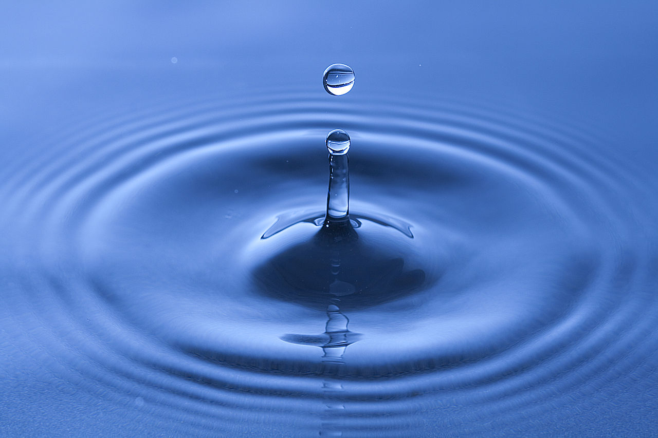
NEW TECHNOLOGY FOR THE 21ST CENTURY
Notes:
Thank you for inviting me to this gathering. My name is Charles Jennings. I am the president and general manager of Jenfitch, Inc. Today, I want to introduce you to a new oxidizing technology-mineral oxychloride

Slide 2
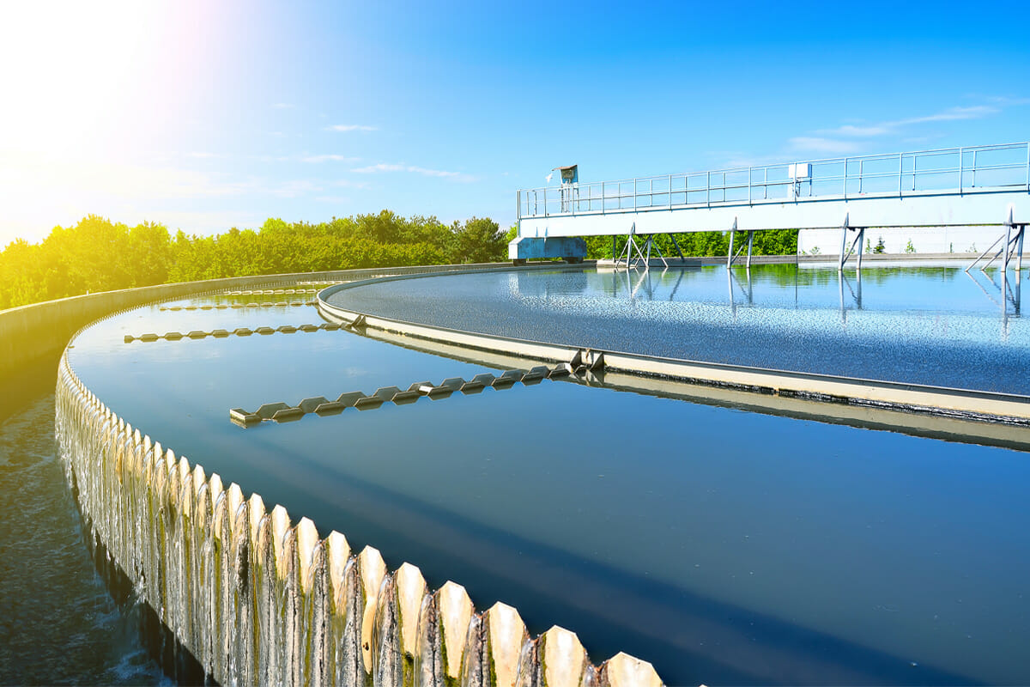
Company History & Development
Jenfitch, Inc. was formed in 2008 to manufacturer and market water treatment chemicals
JC 9450 is a new strong oxidizer, based around the research on mineral oxychloride chemistry that was first developed in the early 1900’s. In the late 20th Century, tools to measure this technology became commercially available and JC 9450 was commercially available from 2013 for: proof of concept studies, plant trials, and laboratory studies and is currently in the marketplace.
Mr. Charles Jennings, owner & General Manager, is leading the research teams and marketing teams to develop JC 9450
Notes:
Before I begin to review this new technology that originated in Norway during the 1920’s as part of their research in nuclear energy, I want to share something about our company. We were formed in 2008. As I mentioned early, mineral oxychloride had its beginning in the 1900’s. The instruments require to analyze is technology was not was not commercially available until the early 60’s. We acquired the rights and began to commercialize it in 2013. Next slide

Slide 3
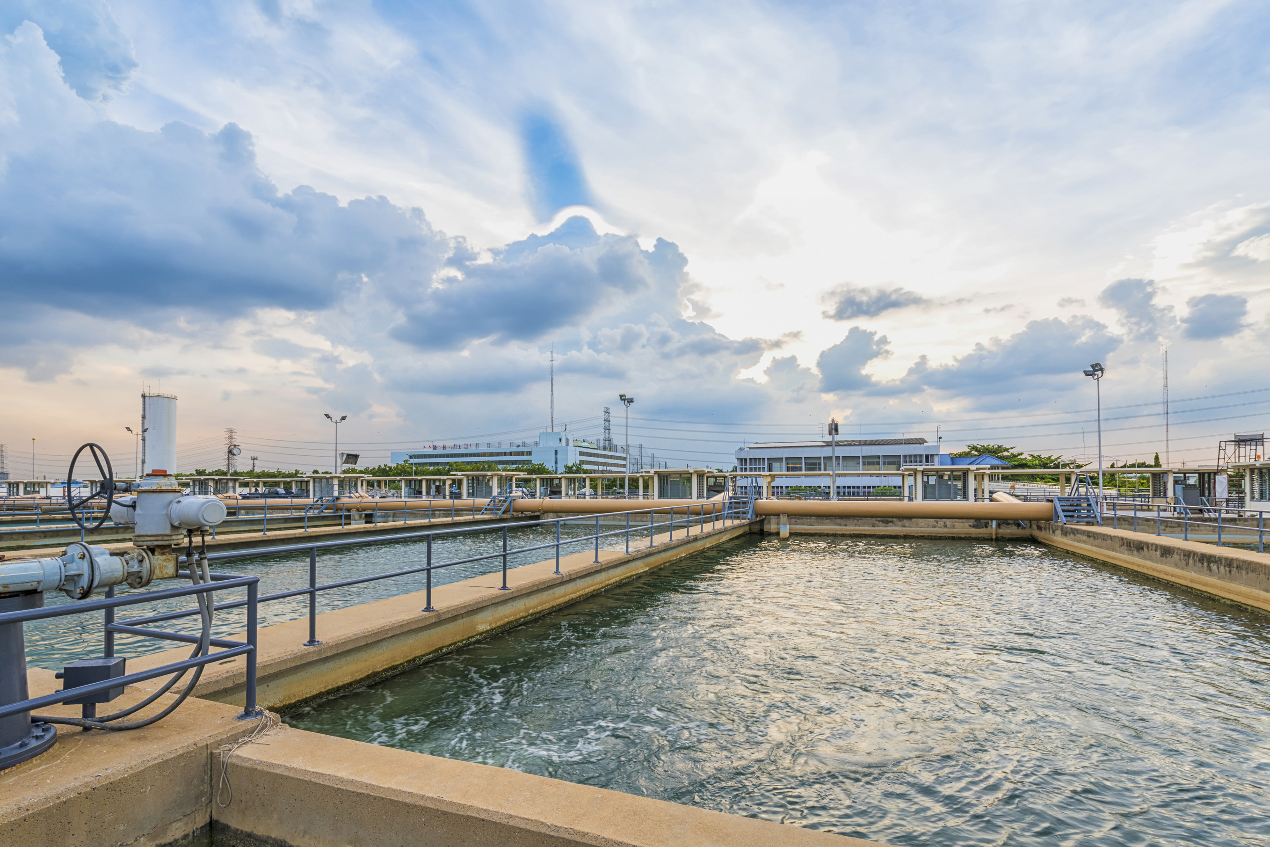


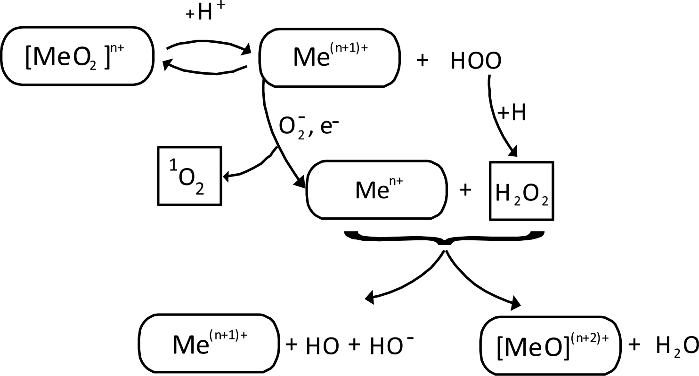
JC 9450 – New Oxidant
JC 9450 is NSF60 approved
JC 9465 is EPA approved
JC 9465 is USDA Organic
JC 9450 is a new oxidative technology for generating reactive oxygen species (ROS) that simulate an advance oxidation process (AOP) as a tool to measure disinfection effectiveness in water treatment solutions.
Notes:
JC 9450 is a new oxidant that generates reactive oxygen species (ROS). In the past several years we have received NSF Standard 60, EPA and Organic certification. In the center of this chart, we demonstrates through ROS, the concept that energy is neither create nor destroy but changes forms-quantum physic. Now the formula below is how we make our mineral oxychloride.

Slide 4
What does JC 9450 offer?
In the past water treatment professionals have been looking for ways to provide safe drinking water effectively.
Today the World Health Organization recommends that water is safe at an ORP greater than +750mV
The laws currently being written recommend the use of Langlier Index (LI) to monitor corrosion and water quality using Oxidation Reduction Potential (ORP) as a way of maintaining safe water standards.
Current EPA guidelines are being discussed to include ORP measurement (as mV) and LI as a matrix for water quality control.
JC 9450 is a low-cost producer of hydroxyl radical ions. JC 9450 is a very strong oxidant with a high concentration of oxidative energy; and it has a higher electronic footprint (E_{v}) vs a chemical footprint that other oxidants.
Notes:
So, why are we here talking to you about mineral oxychloride? There are two concerns that water professionals are looking at currently : 1) water quality and 2)monitoring corrosion. The answer maybe with ORP and LI. So what is so important about oxidation and what is an electronic footprint? Next slide

Slide 5
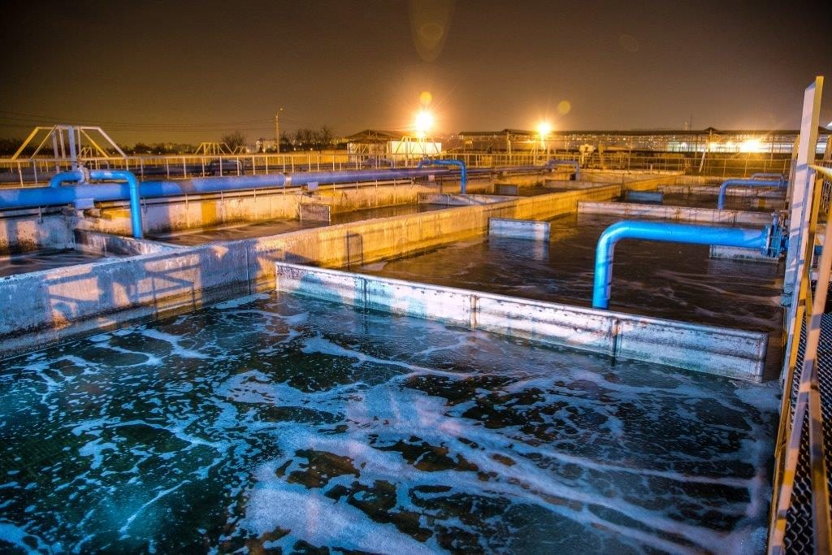
Electrochemical Potential (E_{v}) a measurement of oxidative energy
JC 9450 is 2.8 to 2.9 E_{v}
Ozone is 2.07 E_{v}
Sodium Hypochlorite is 0.94 E_{v}
Chlorine Dioxide is 1.57 E_{v}
Chlorine Gas is 1.36 E_{v}
Notes:
Electronic footprint!! As scientist and stakeholders, we are always looking to improve the following: 1) lower cost, 2) improved results and 3) better ways of doing our jobs. Every oxidant has an electrochemical potential Ev. The higher the better. Which one are you using? Next slide

Slide 6
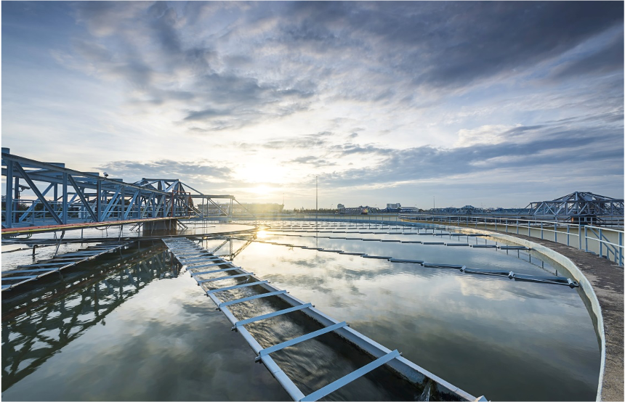
Why is ORP Important to Disinfection
Measures energy available for disinfection
Measures contact time required for disinfection
Optimizing treatment based on system demand
Notes:
Think of using an ORP meter to control oxidation and regulate your disinfectant. Is Ozone the most powerful disinfectant in the market? Next slide

Slide 7
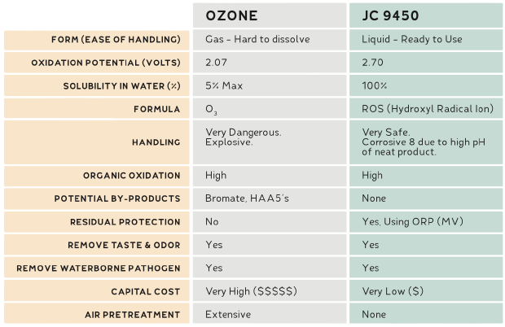

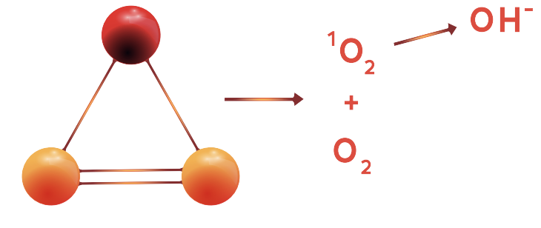

Ozone vs. JC 9450
JC 9450/9465
Notes:
As you know, Ozone is oxygen and energy!! But what happens with it when it breaks down? Let’s look at JC 9450’s reaction when added to water. The same results as ozone but a higher Ev

Slide 8
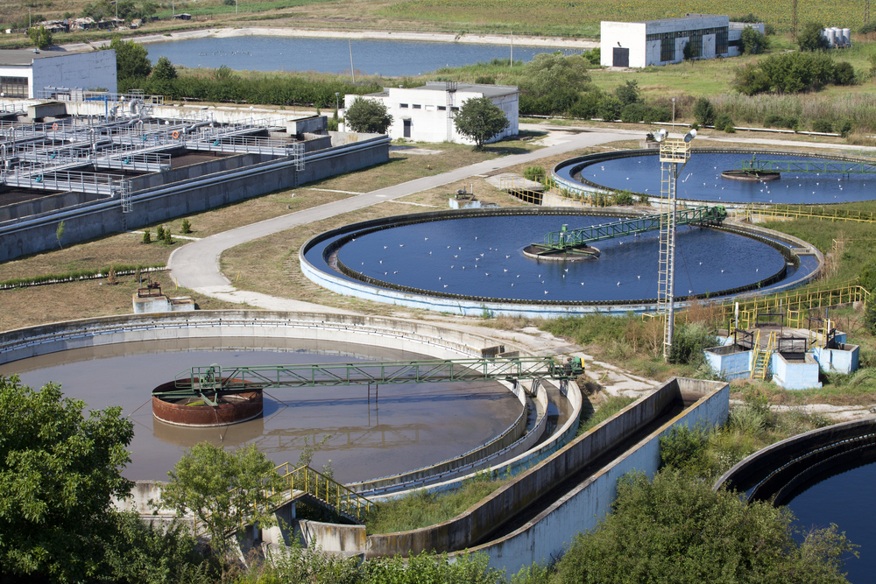
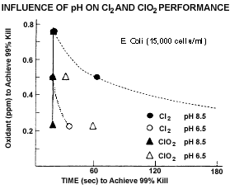
JC 9450/9465 vs Chlorine
JC 9450 can achieve a six-log reduction in less than 10 seconds @ 700+ mV or higher
JC 9450 outperforms chlorine at a lower dosage (using ORP and dosage as measurement)
JC 9450 is not pH dependent, and has a higher ORP going beyond Chlorine (equivalent dosages)
Takes too long to kill pathogens
Requires more chlorine for less results
Is an explosive gas and corrosive
This chart is based on using free available chlorine as a benchmark and reflects only a 4-log reduction vs time.
Notes:
In this chart I want to talk about the difference between chlorine and JC 9450. For chlorine to be effective it needs time (t) and concentration (c) or CT . This chart show a 4-log reduction at varying pH in distilled water with an e.coli (gram-negative bacilli) culture and chlorine vs chlorine dioxide. Next slide

Slide 9
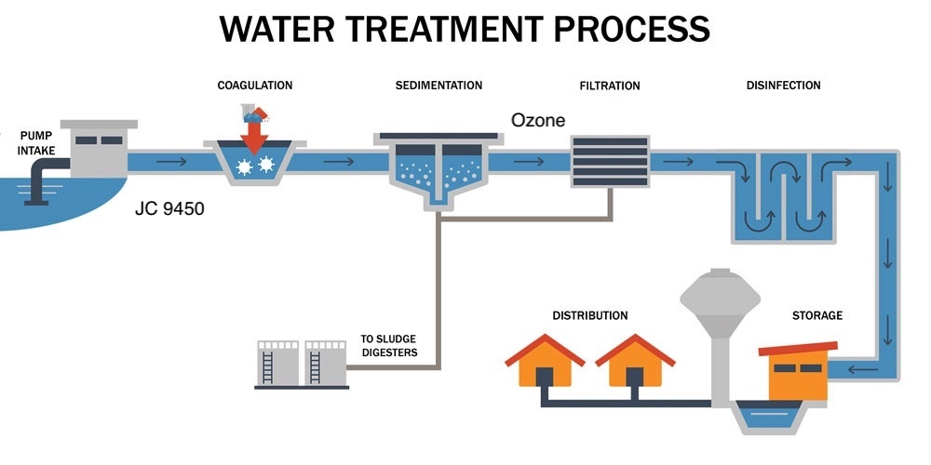
/9465
Post-treatment monitoring
Notes:
We started feeding JC 9450 at 10 mg/l in front of the flash mixer. We were able to turn the ozone generator down to 40% and maintain 0.2 mg/l to 0.3 mg/l. Big energy saver!! We saw a reduction in chlorine usage .

Slide 10
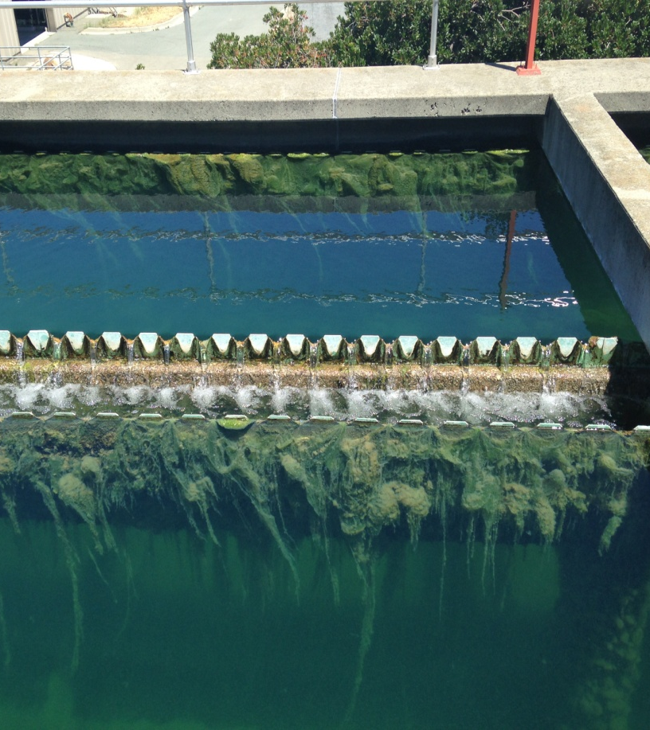
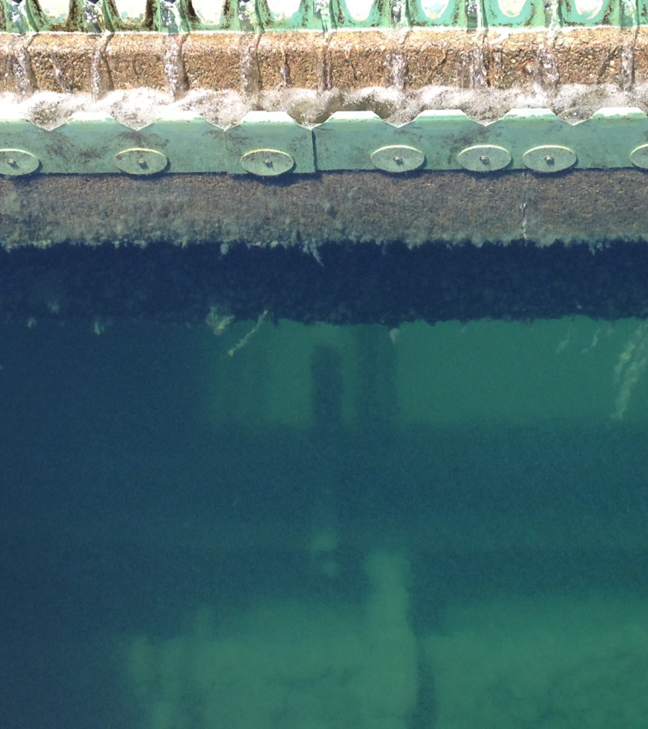
JC 9450/9465 Removes Biofilm and Improves System Efficiency
BEFORE
AFTER
Algae overgrown on weirs from clarifying tank
Biofilm was controlled and algae was eliminated

Slide 11
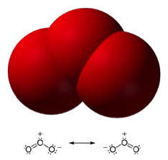
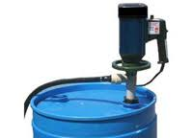
Installation
Handling Properties of JC 9450/9465
Liquid requires rubber gloves, face shield, shirt with sleeves
Corrosive in undiluted form, will freeze
Six Month Shelf-life vs 30 day for NaHOCL
Installation of this technology takes less than 30 minutes and requires no additional equipment
Simple to use and monitor
Low capital investment
Easy installation and used in multiple applications in the water treatment facility
Metering pump & drum at injection site regular containment
Notes:
JC 9450 is a corrosive liquid that handles like sodium hypochlorite. It has a six-month shelf life. Installation for plant use is simple- a metering pump and a container

Slide 12
Other Applications
JC 9450/9465 is NSF60 approved
JC 9465 is EPA approved
JC 9465 is USDA Organic
Food Preparation and Food Safety
Wastewater Treatment
Fe & Mn Treatment
Potable Water Treatment
Zebra Mussel Treatment
Oil and Gas
Food & Beverage Processing
Water Recycling
Desalination Plants
Cooling Towers
Healthcare and Life Sciences
Well Water Treatment
Post Harvest Agriculture
Hospitality
Notes:
Again, I want to mention that we are approved in USA with NSF, EPA and USDA Organic. I have included a list of various applications for our technology that we have explored so far.

Slide 13

Let’s get started
Plant trials partnerships
  Municipal Water Treatment Pilot
  Wastewater Treatment Pilots
  Desalination Studies
  Water Recycle and Reuse Projects
Pilot Studies partnership
  Controlling Biofilm in the distribution system
  Lowering or reducing the formation of TTHM’s and HAA5’s
  Lowering or reducing iron and manganese
  Lowering or eliminating Taste and Odor complaints
  Eliminating the influence of zebra mussels
Earning Contact Time (CT) Credit as a primary disinfectant
Notes:
The main purpose of my presentation was to seek the opportunity to develop more proof-of-concepts around this technology in the potable and wastewater industry. Our main focus has been in North America. Everyday I am getting inquiries from all over the world about this technology. Want to start developing relationships in other countries.

Slide 14
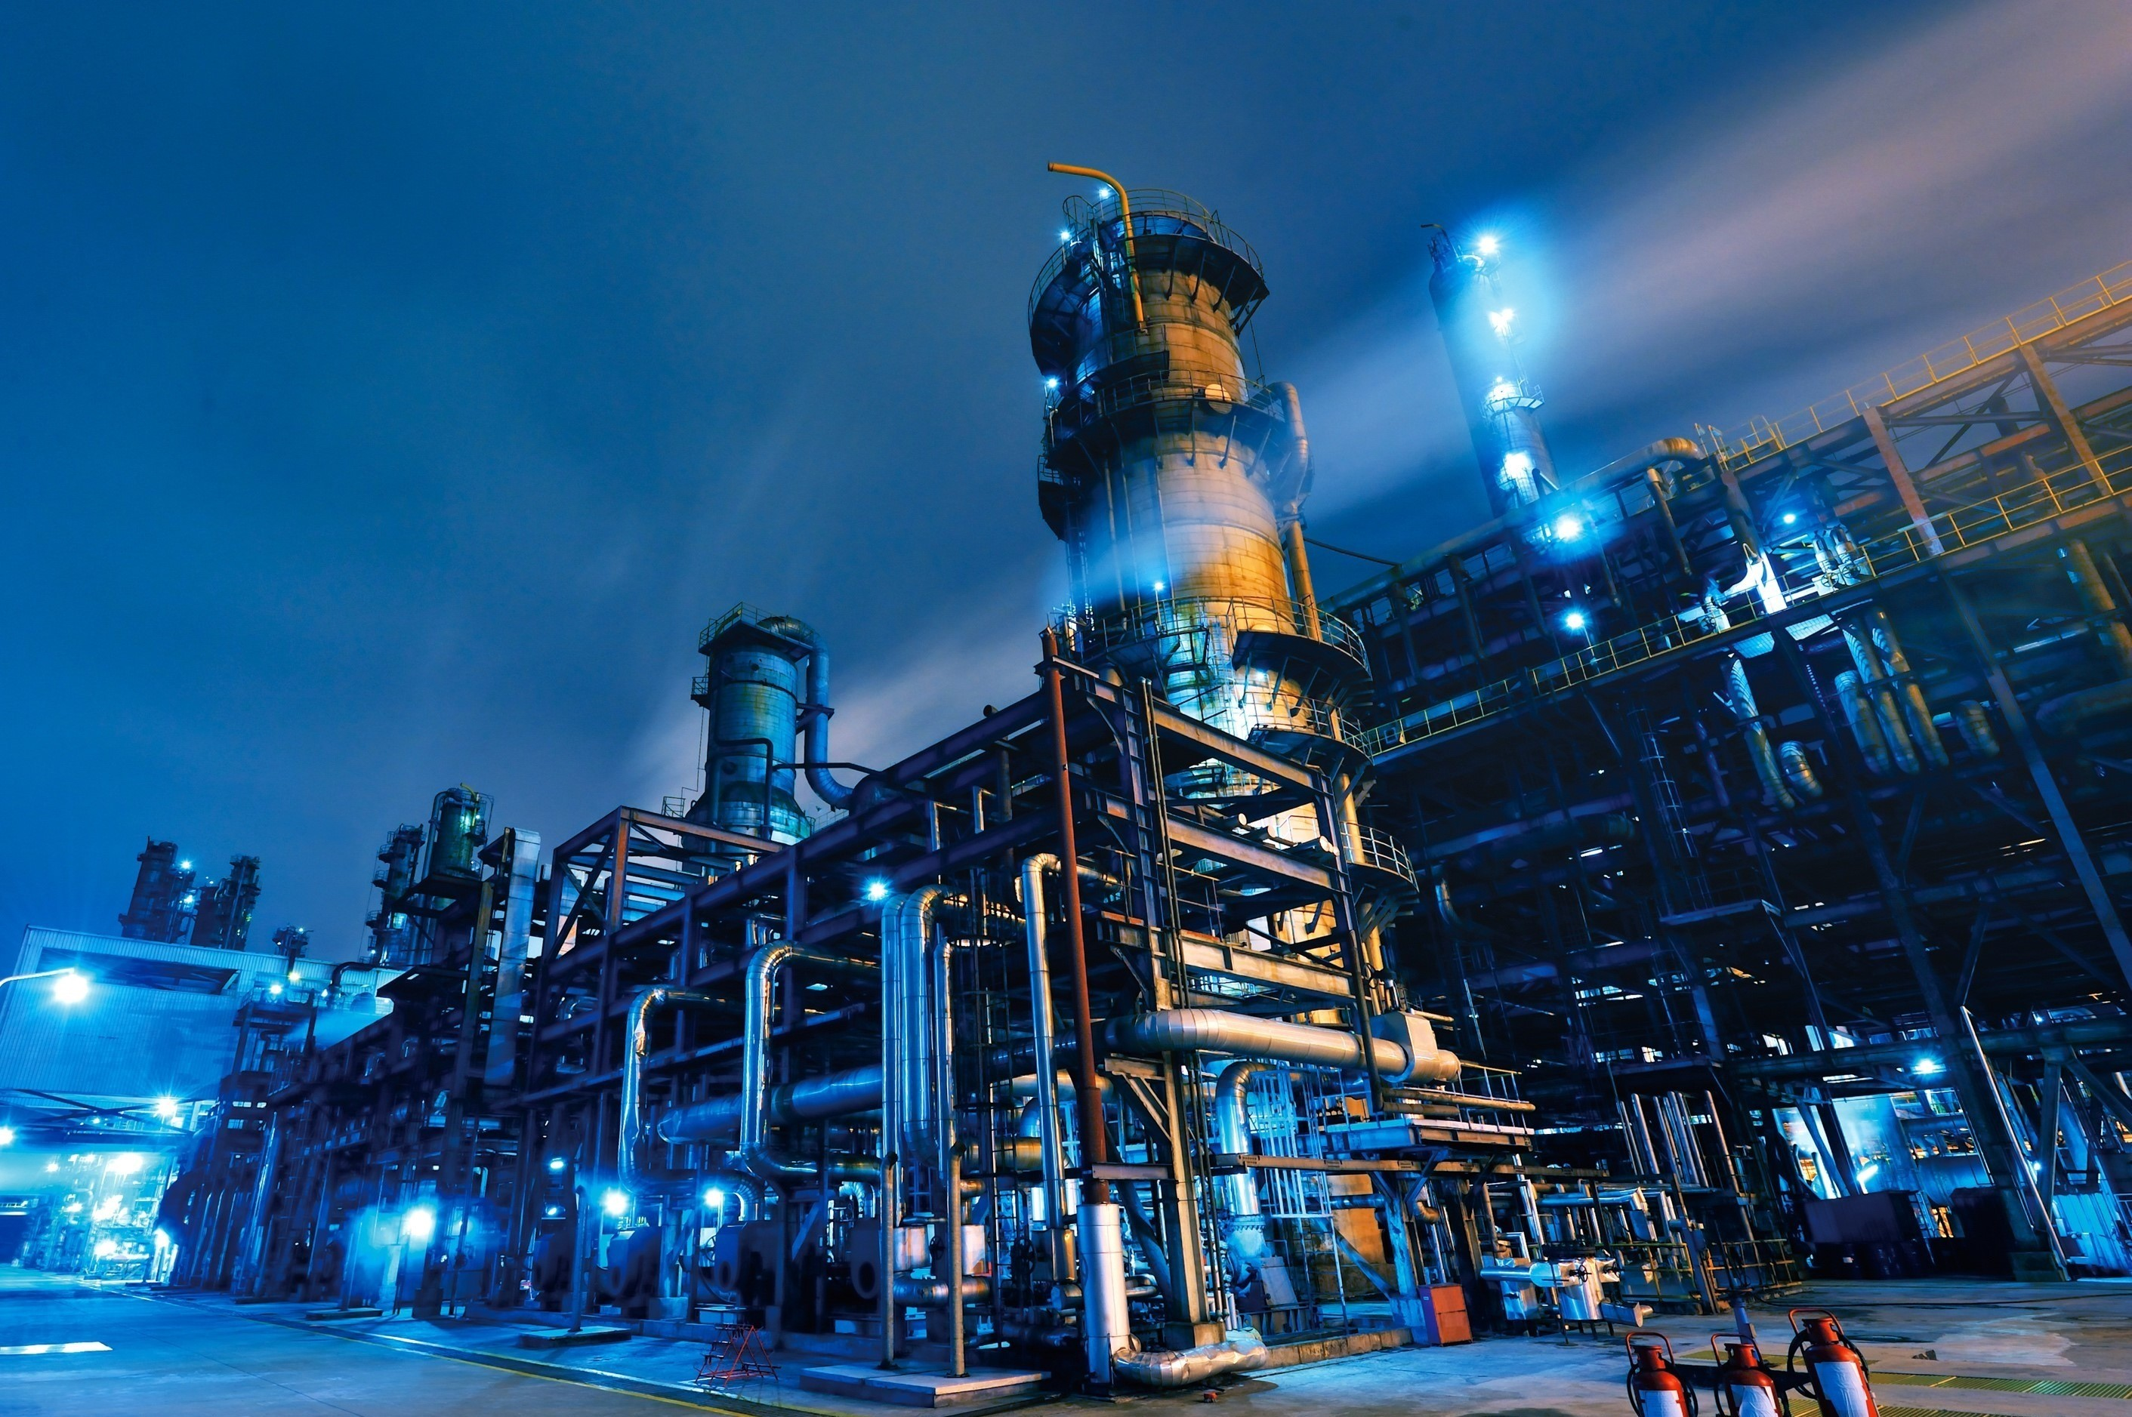
Summary
We want to run more pilot studies in water systems impacted by THM’s and HAA5’s
We are looking for water plants with T & O complaints
We want to demonstrate biofilm removal
We want to do a study on removal Zebra Mussels
Notes:
We, at Jenfitch, believe in the importance of continuing to develop our understanding of this technology. With your help, we can increase the wealth of knowledge through pilot studies and field testing. Next slide

Slide 15

Thank you
JC 9450/9465
Charles Jennings
Jenfitch.com • t: 925-289-3559 x102
712 Bancroft Rd #805, Walnut Creek, California 94598 • Made in the USA
Notes:
My goal is to help bring about an ever-advancing civilization. By providing safe drinking water. We are helping humankind. Thank you for your support

